Slide 1
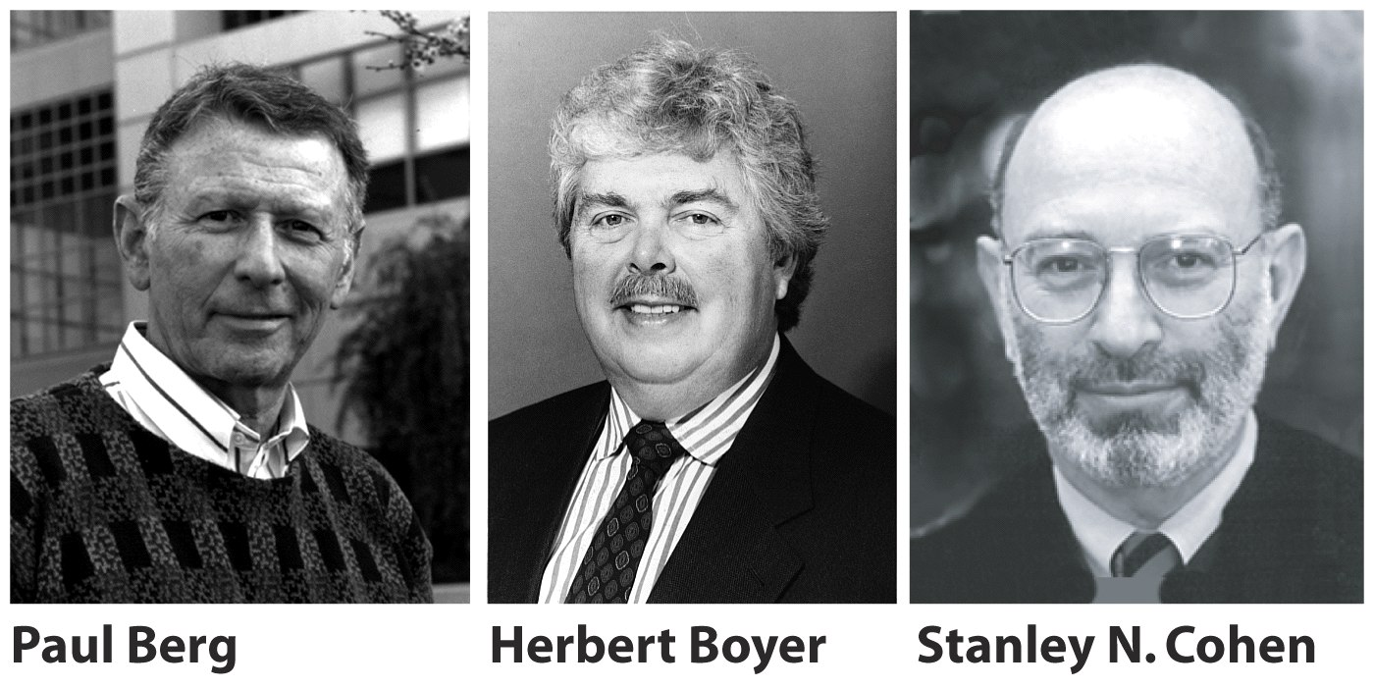
Techniques of Molecular Biology
Analyzing and manipulating DNA
Isolating, cloning, and sequencing DNA

Slide 2
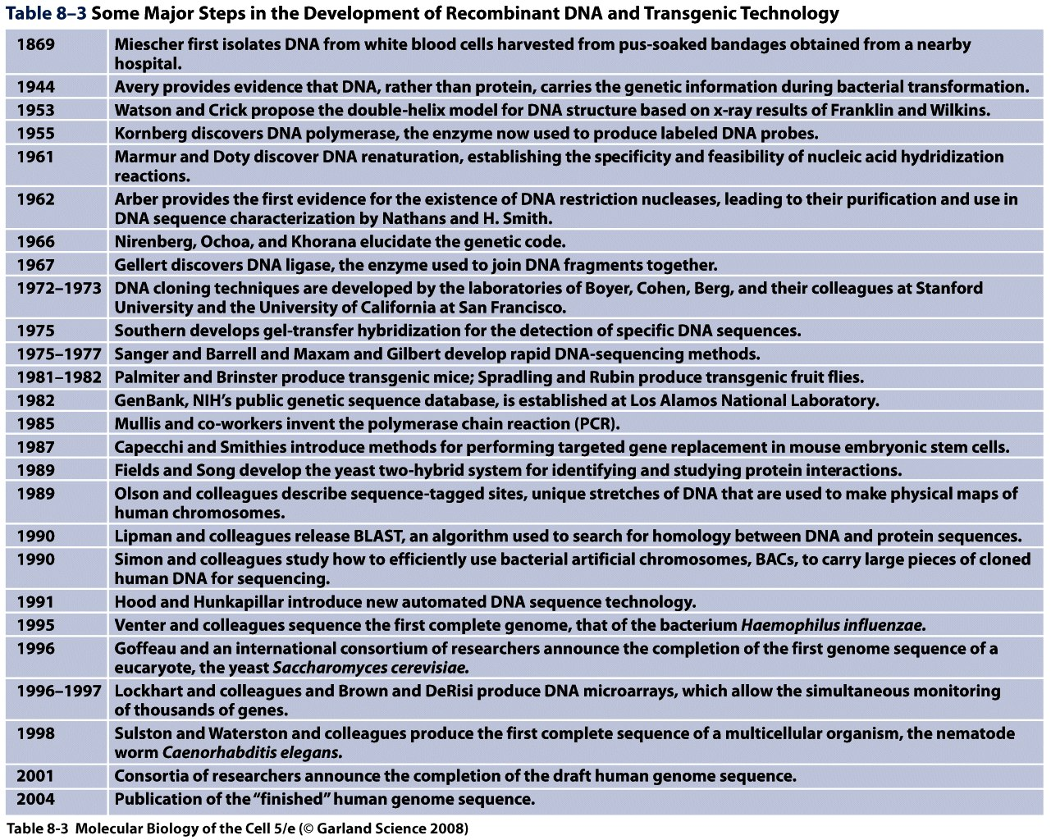

Slide 4
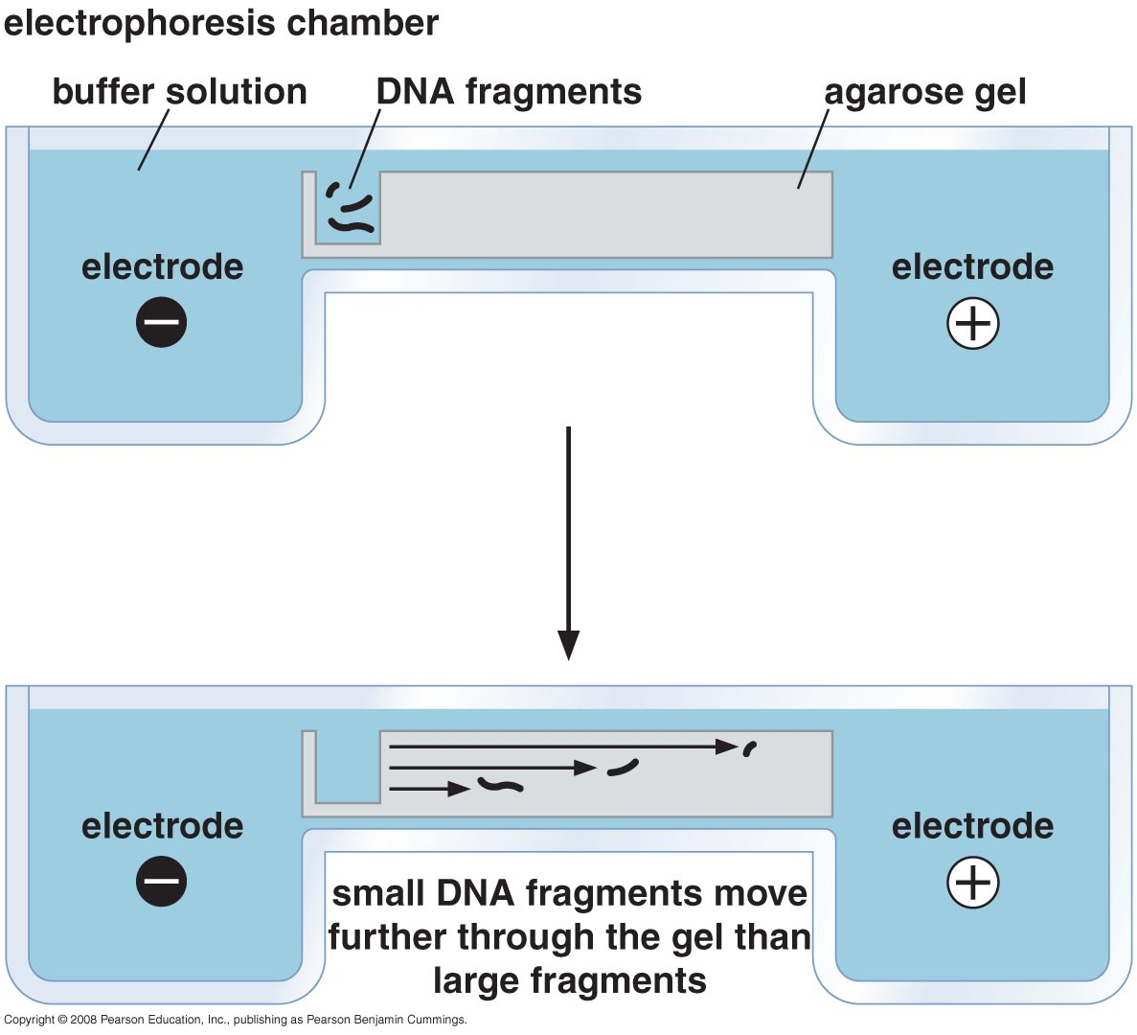
Electrophoresis through a gel separates DNA and RNA according to size

Slide 5
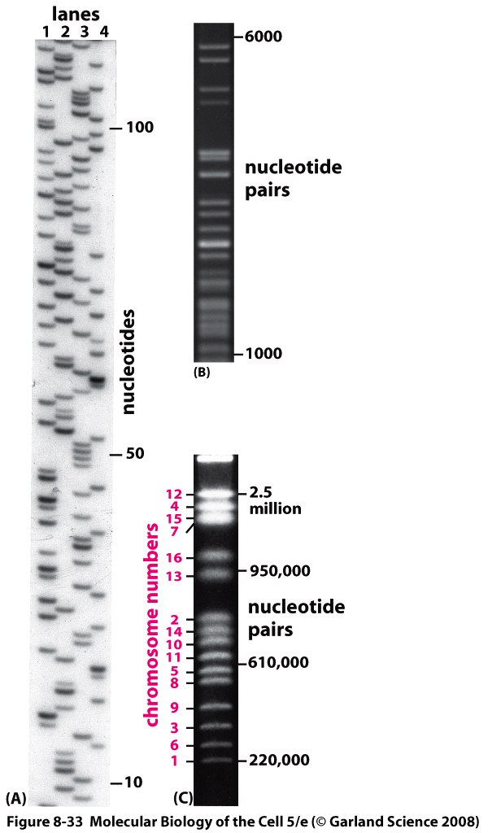
Gel electrophoresis techniques for separating DNA molecules by size.
Polyacrylamide
Agarose
Pulse-field

Slide 6
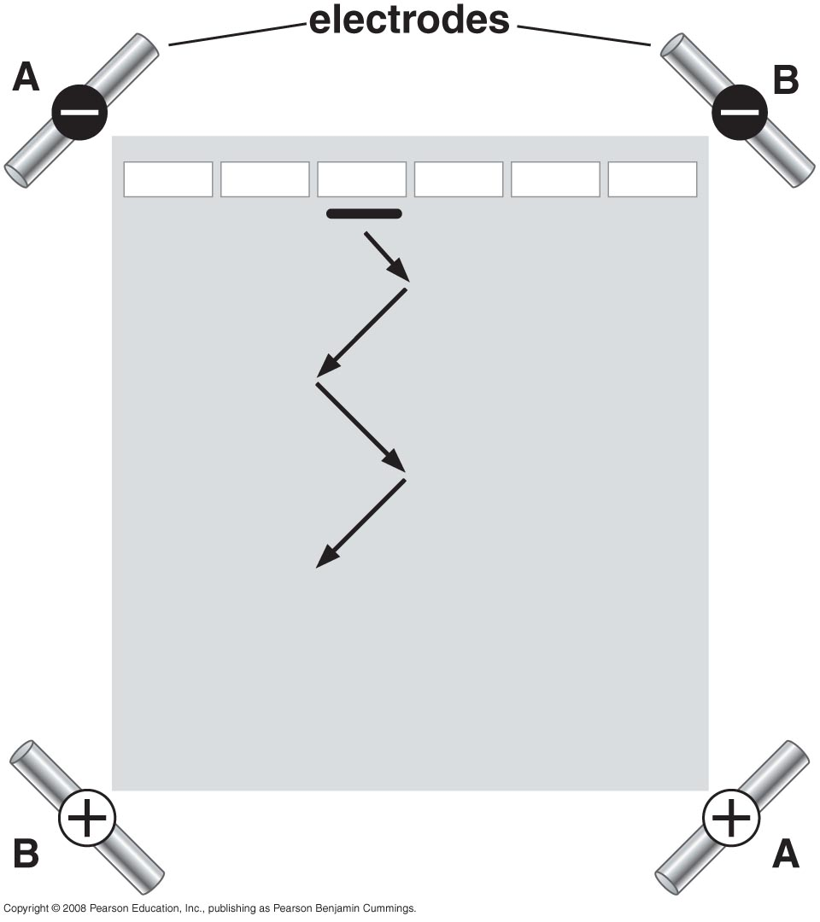
Pulsed-field gel electrophoresis

Slide 7
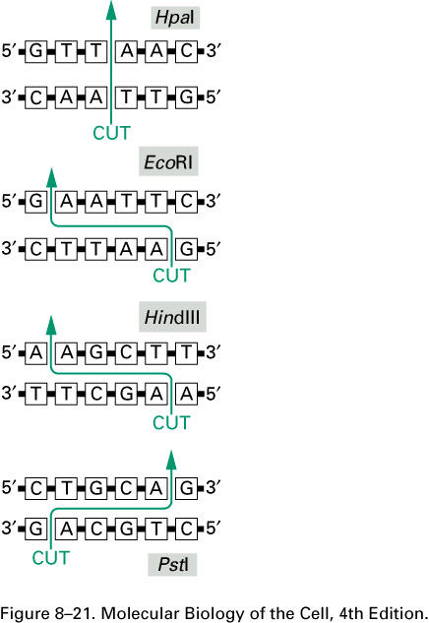
Restriction nuclease cut large DNA molecules at particular sites into fragments
The DNA nucleotide sequences recognized by four widely used restriction nucleases. As in the examples shown, such sequences are often six base pairs long and “palindromic” (that is, the nucleotide sequence is the same if the helix is turned by 180 degrees around the center of the short region of helix that is recognized). The enzymes cut the two strands of DNA at or near the recognition sequence. For some enzymes, such as HpaI, the cleavage leaves blunt ends; for others, such as EcoRI, HindIII, and PstI, the cleavage is staggered and creates cohesive ends. Restriction nucleases are obtained from various species of bacteria: HpaI is from Hemophilus parainfluenzae, EcoRI is from Escherichia coli, HindIII is from Hemophilus influenzae, and PstI is from Providencia stuartii.

Slide 8
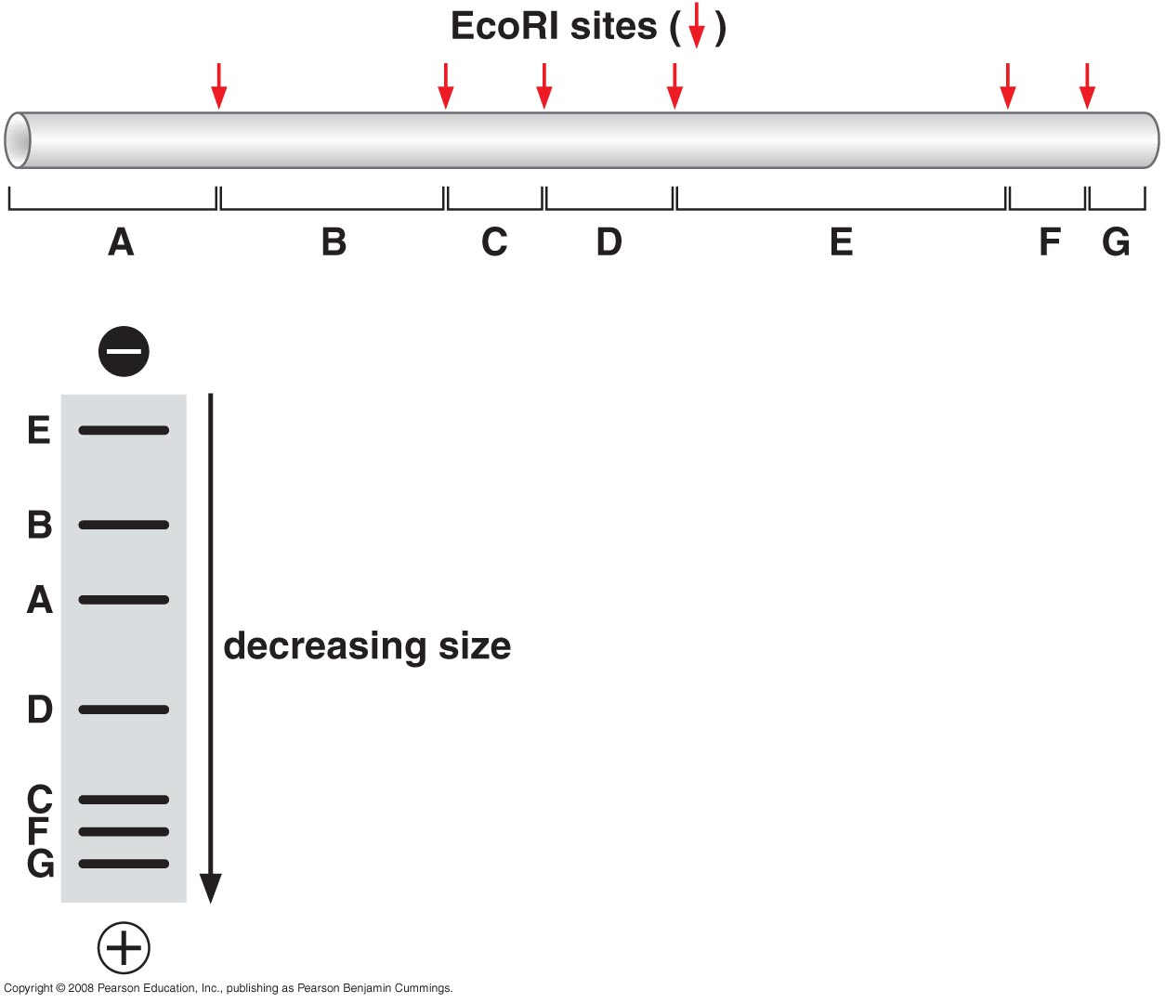

Slide 9
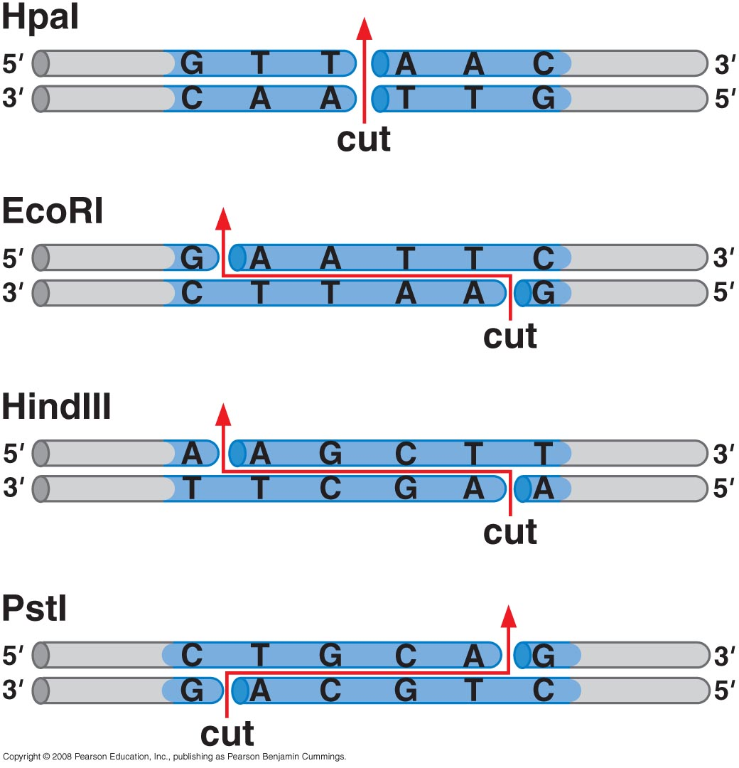
21_Figure04.jpg

Slide 10
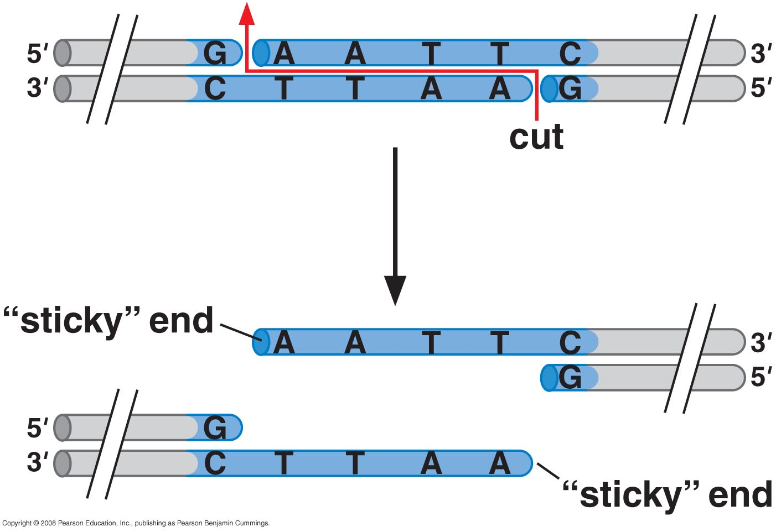
Cleavage of EcoRI site

Slide 11
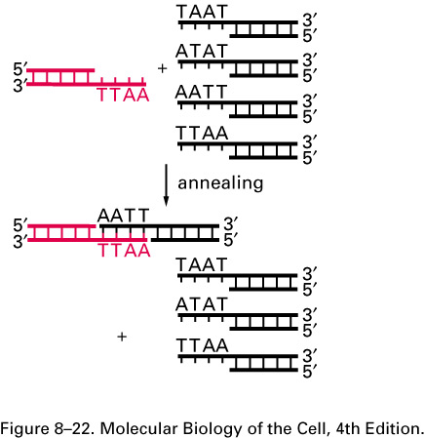
Restriction nucleases produce DNA fragments that can be easily joined together.
Fragments with the same cohesive ends can readily join by complementary base-pairing between their cohesive ends, as illustrated. The two DNA fragments that join in this example were both produced by the EcoRI restriction nuclease, whereas the three other fragments were produced by different restriction nucleases that generated different cohesive ends (see Figure 8–21). Blunt-ended fragments, like those generated by HpaI (see Figure 8–21), can be spliced together with more difficulty.

Slide 12
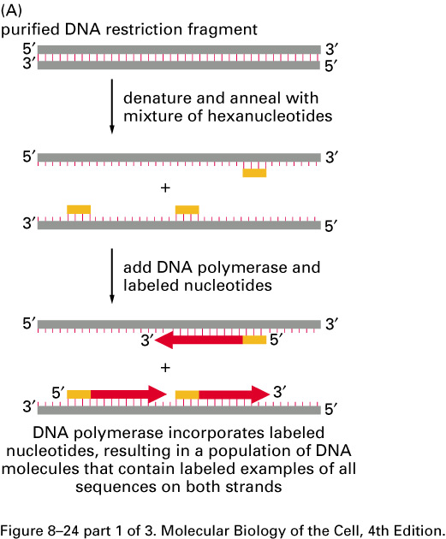
Purified DNA can be labeled with radioactive or chemical markers
Methods for labeling DNA molecules in vitro.
(A) A purified DNA polymerase enzyme labels all the nucleotides in a DNA molecule and can thereby produce highly radioactive DNA probes. (B) Polynucleotide kinase labels only the 5' ends of DNA strands; therefore, when labeling is followed by restriction nuclease cleavage, as shown, DNA molecules containing a single 5'-end-labeled strand can be readily obtained. (C) The method in (A) is also used to produce nonradioactive DNA molecules that carry a specific chemical marker that can be detected with an appropriate antibody. The modified nucleotide shown can be incorporated into DNA by DNA polymerase so as to allow the DNA molecule to serve as a probe that can be readily detected. The base on the nucleoside triphosphate shown is an analog of thymine in which the methyl group on T has been replaced by a spacer arm linked to the plant steroid digoxigenin. To visualize the probe, the digoxigenin is detected by a specific antibody coupled to a visible marker such as a fluorescent dye. Other chemical labels such as biotin can be attached to nucleotides and used in essentially the same way.

Slide 13
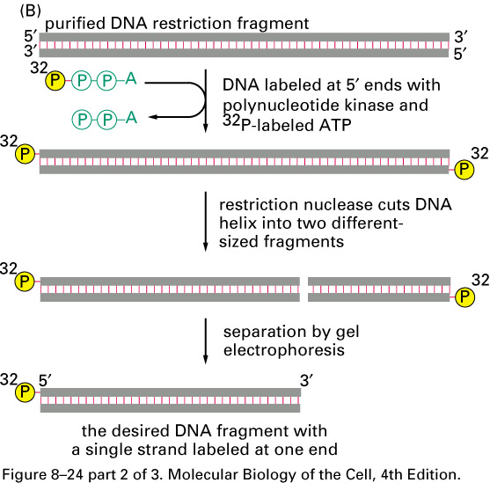
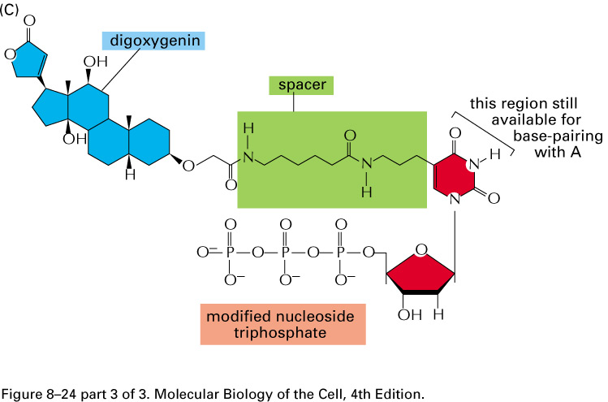

Slide 14
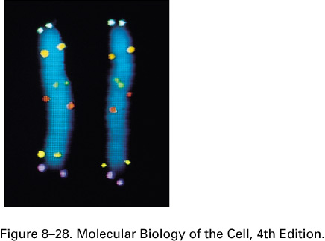
DNA hybridization can be used to identify specific DNA molecules
In situ hybridization to locate specific genes on chromosomes.
Here, six different DNA probes have been used to mark the location of their respective nucleotide sequences on human chromosome 5 at metaphase. The probes have been chemically labeled and detected with fluorescent antibodies. Both copies of chromosome 5 are shown, aligned side by side. Each probe produces two dots on each chromosome, since a metaphase chromosome has replicated its DNA and therefore contains two identical DNA helices.

Slide 15
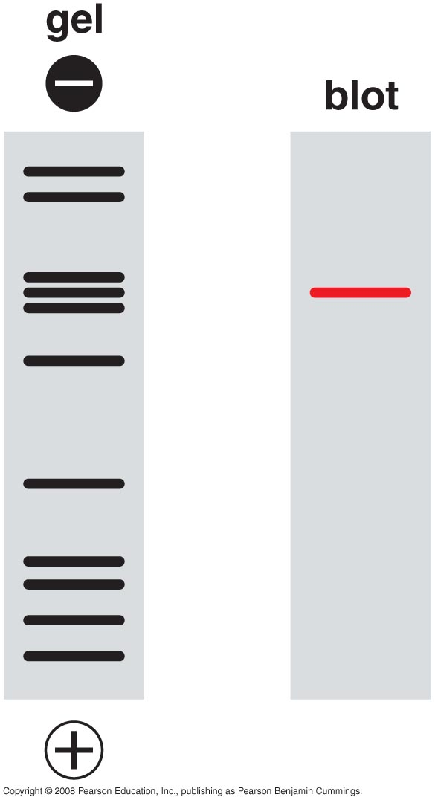
Hybridization probes can identify electrophoretically separated DNA and RNAs

Slide 16
Northern and Southern blotting facilitate hybridization with electrophoretically separated nucleic acid molecules
Southern Blots
Another way to find desired fragments
Subject the DNA library to agarose gel electrophoresis
Soak gel in NaOH to convert dsDNA to ssDNA
Neutralize and blot gel with nitrocellulose sheet
Nitrocellulose immobilizes ssDNA
Incubate sheet with labeled oligonucleotide probes
Autoradiography should show location of desired fragment(s)

Slide 17
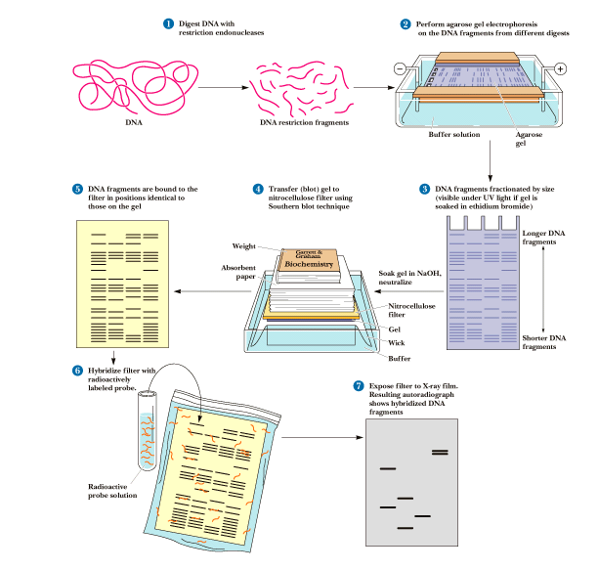

Slide 18
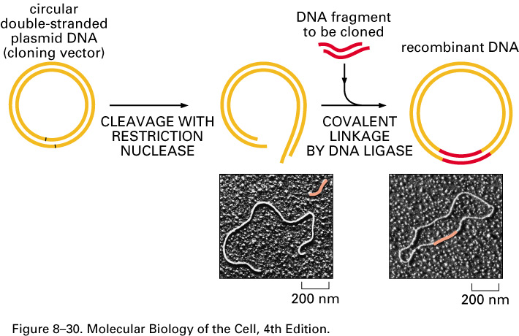
Isolation of Specific segments of DNA:
DNA cloning: DNA (Genes) Can be cloned from a DNA library
The insertion of a DNA fragment into a bacterial plasmid with the enzyme DNA ligase. The plasmid is cut open with a restriction nuclease (in this case one that produces cohesive ends) and is mixed with the DNA fragment to be cloned (which has been prepared with the same restriction nuclease), DNA ligase, and ATP. The cohesive ends base-pair, and DNA ligase seals the nicks in the DNA backbone, producing a complete recombinant DNA molecule.

Slide 19
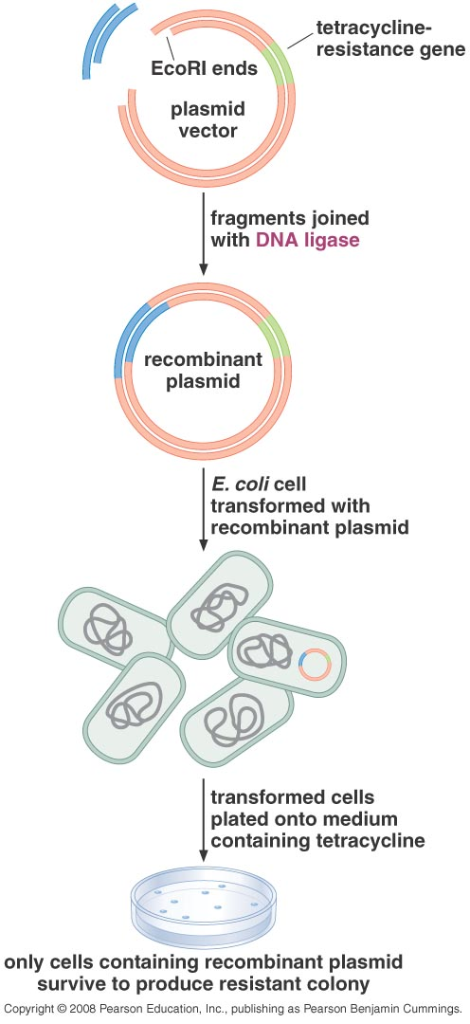
Cloning DNA in plasmid vectors

Slide 20
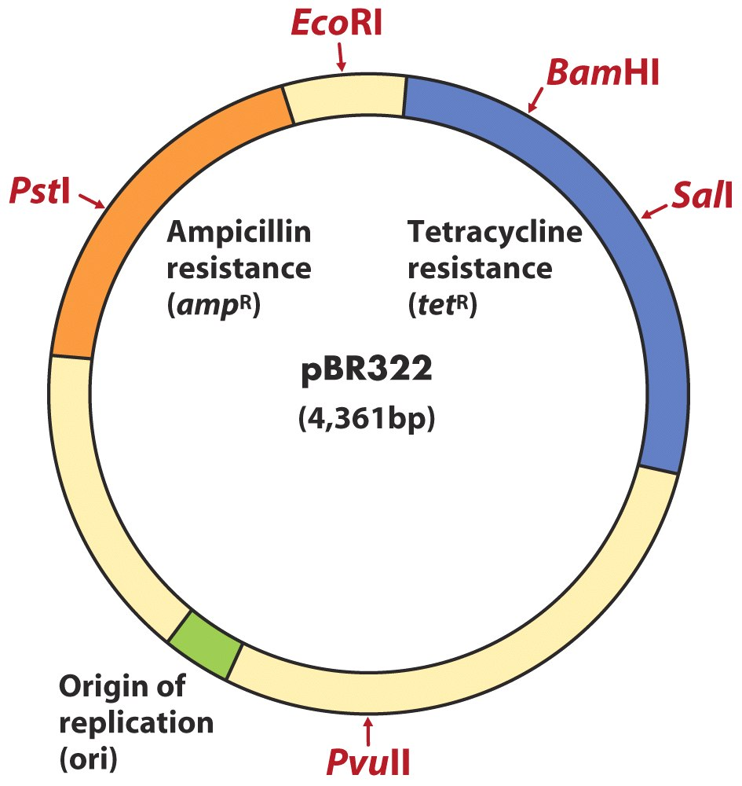
Cloning vectors allow amplification of inserted DNA segments
E coli plasmid pBR 322
Origin of replication
Antibiotic resistance genes
Unique restriction sites
Small size

Slide 21
Plasmids that can be modified to carry new genes
Plasmids useful as cloning vectors must have
a replicator (origin of replication)
a selectable marker (antibiotic resistance gene)
a cloning site (site where insertion of foreign DNA will not disrupt replication or inactivate essential markers

Slide 22
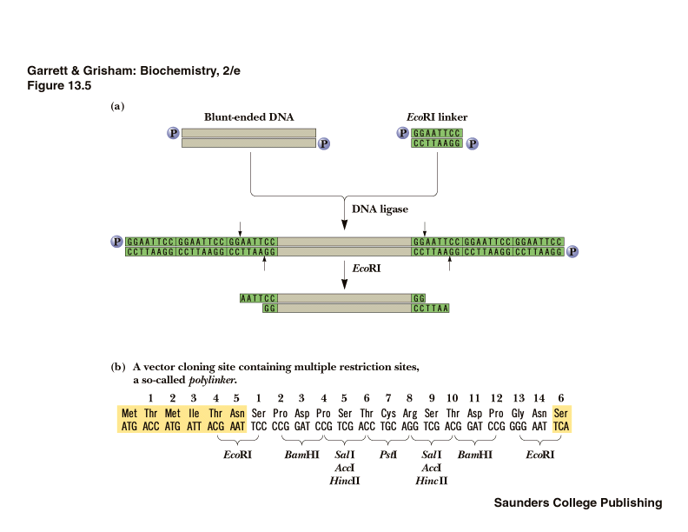

Slide 23
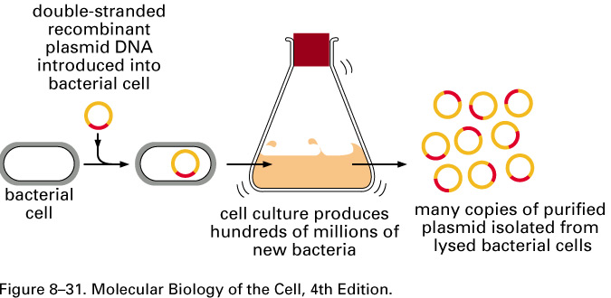
Vector DNA can be introduced into host cells by transformation

Slide 24
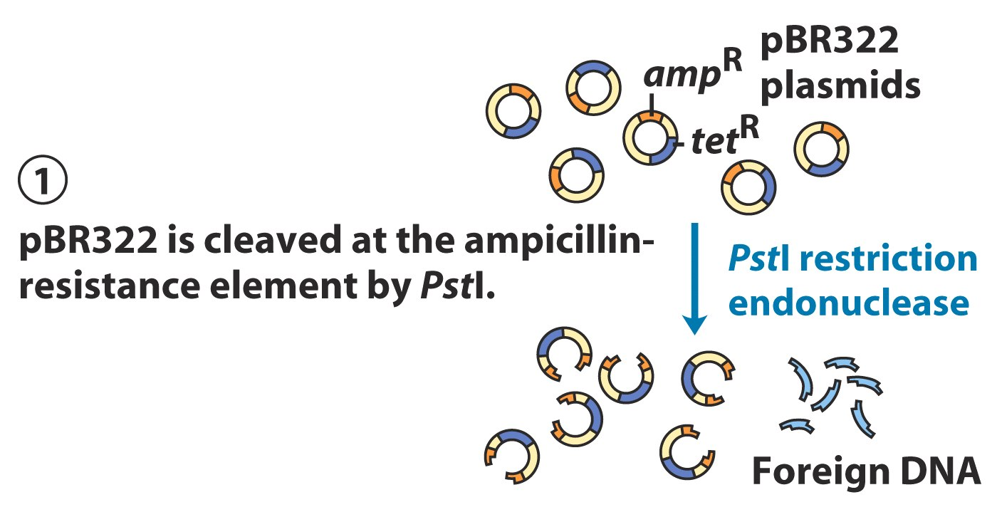
Use of pBR 322 to clone and identify foreign DNA in E. coli

Slide 25
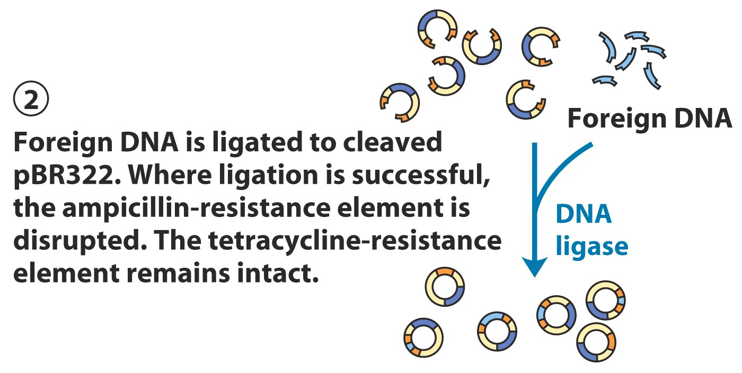

Slide 26
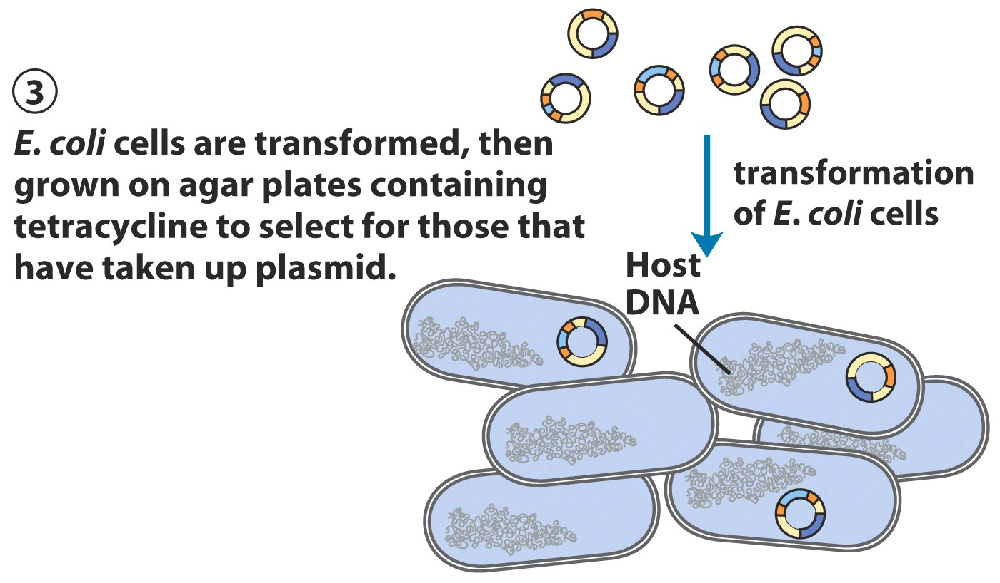

Slide 27
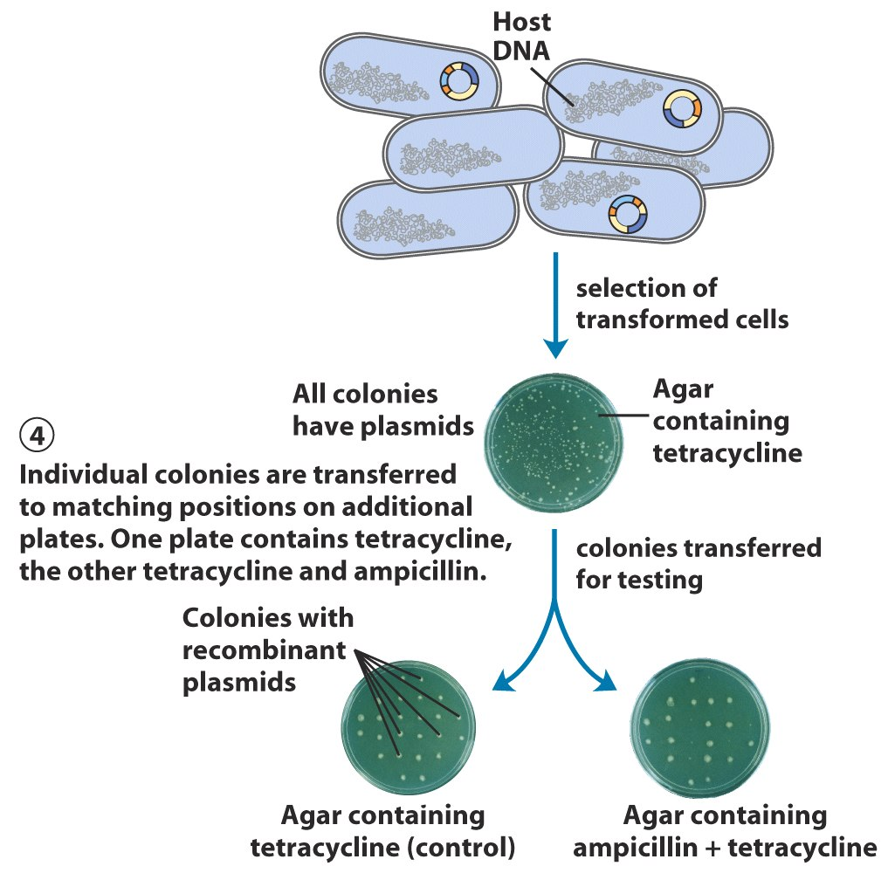

Slide 28
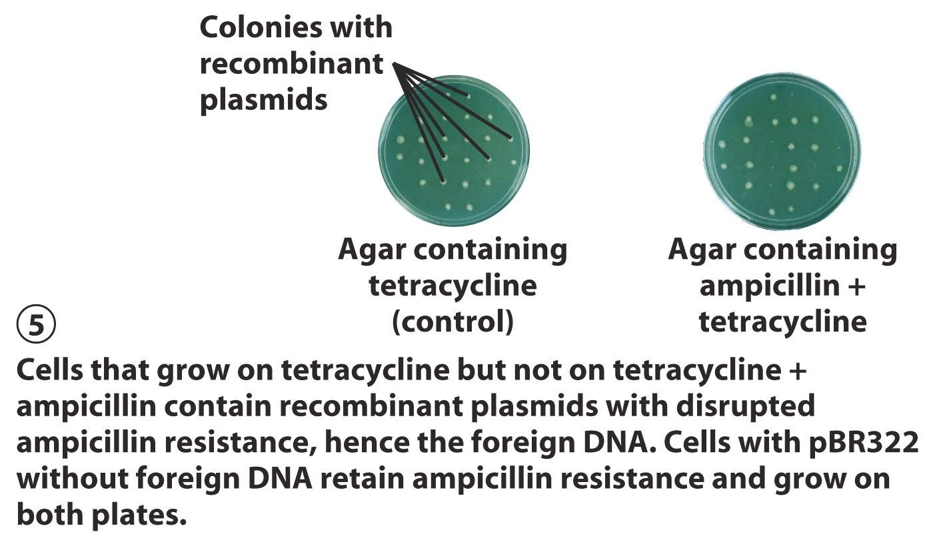

Slide 29
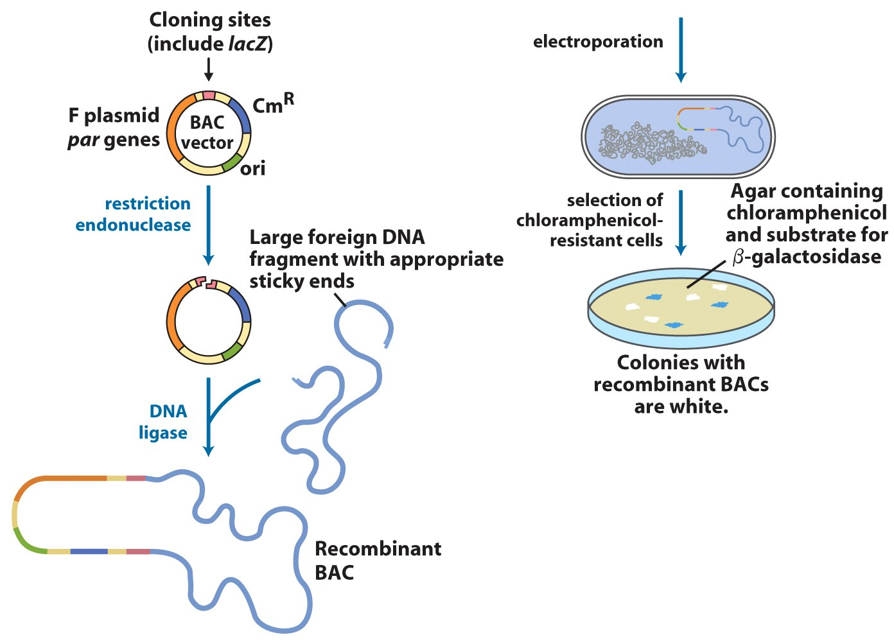
Bacterial artificial chromosomes (BACs)

Slide 30
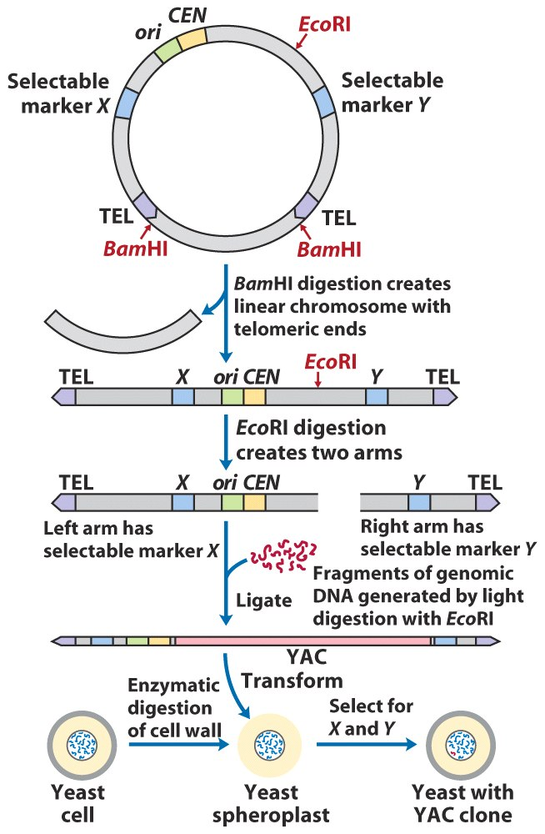
Yeast Artificial Chromosome (YAC)

Slide 31
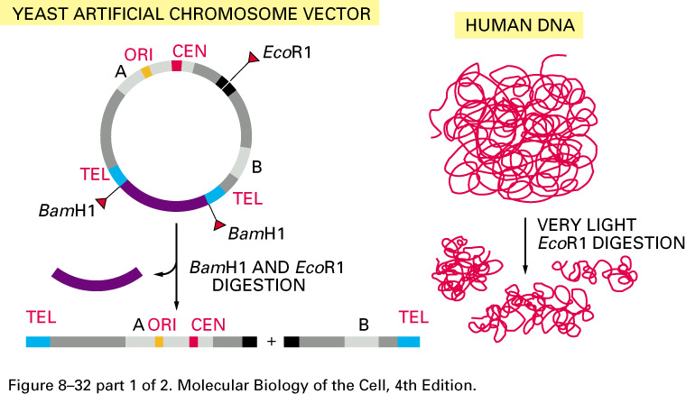
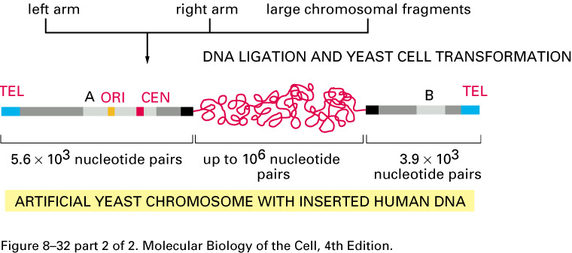
The making of a yeast artificial chromosome (YAC).
A YAC vector allows the cloning of very large DNA molecules. TEL, CEN, and ORI are the telomere, centromere, and origin of replication sequences, respectively, for the yeast Saccharomyces cerevisiae. BamH1 and EcoR1 are sites where the corresponding restriction nucleases cut the DNA double helix. The sequences denoted A and B encode enzymes that serve as selectable markers to allow the easy isolation of yeast cells that have taken up the artificial chromosome.

Slide 32
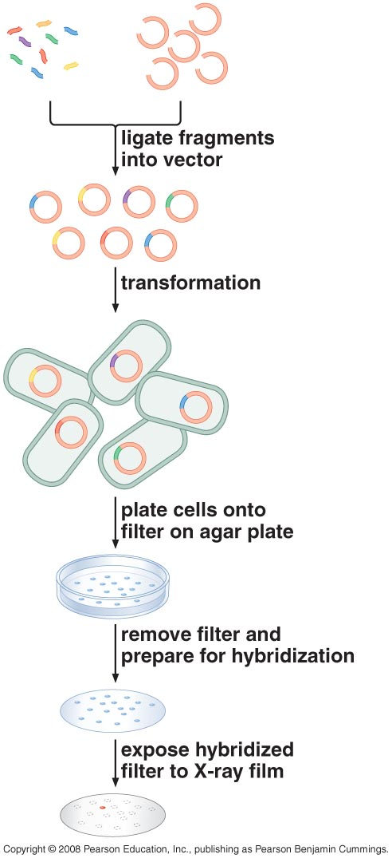
Libraries of DNA molecules can be created by cloning

Slide 33
Two types of DNA libraries serve different purposes
Sets of cloned DNA fragments that together represent the genes of a particular organism
Any particular gene may represent a tiny, tiny fraction of the DNA in a given cell
Can't isolate it directly
Trick is to find the fragment or fragments in the library that contain the desired gene

Slide 34
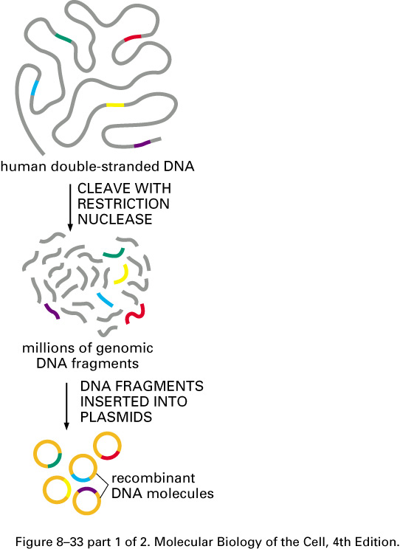
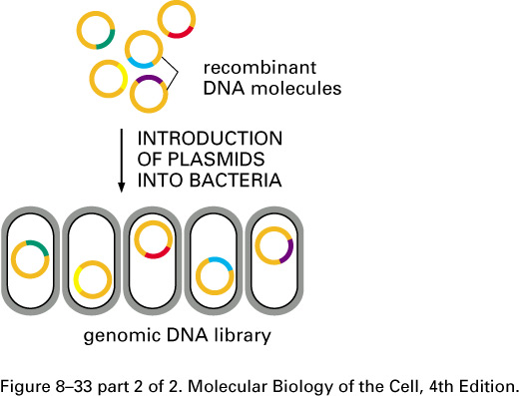
Construction of a human genomic DNA library.
A genomic library is usually stored as a set of bacteria, each carrying a different fragment of human DNA. For simplicity, cloning of just a few representative fragments (colored) is shown. In reality, all of the gray DNA fragments would also be cloned

Slide 35
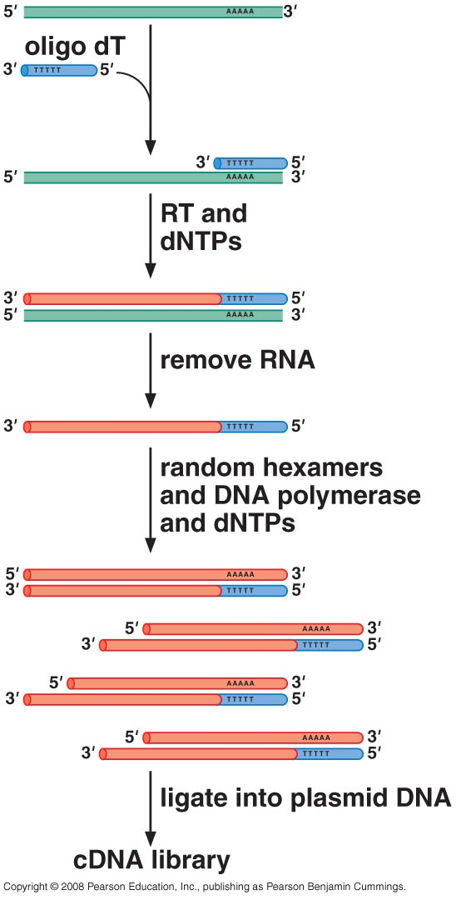
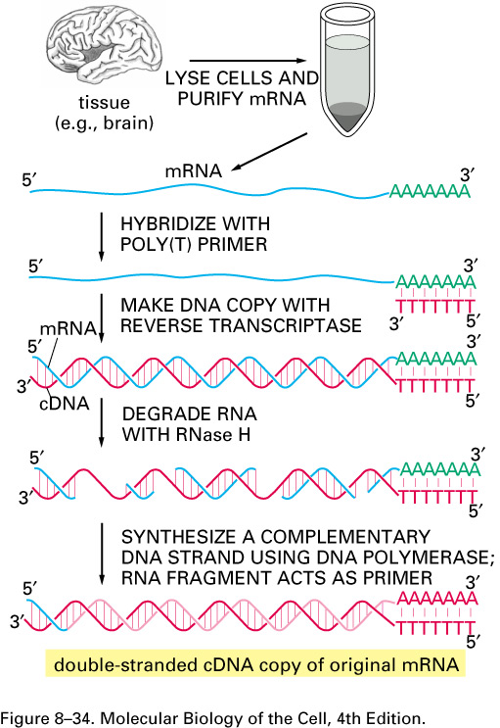
Construction of a cDNA library

Slide 36
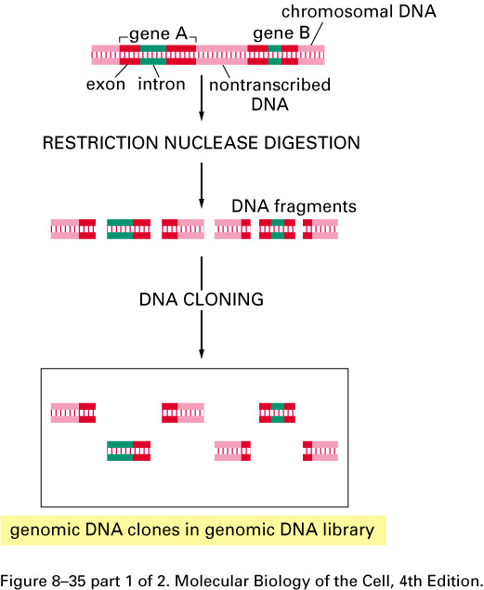
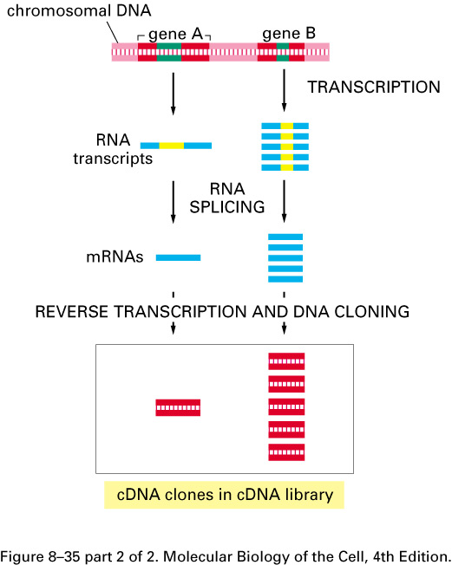
The differences between cDNA clones and genomic DNA clones derived from the same region of DNA. In this example gene A is infrequently transcribed, whereas gene B is frequently transcribed, and both genes contain introns (green). In the genomic DNA library, both the introns and the nontranscribed DNA (pink) are included in the clones, and most clones contain, at most, only part of the coding sequence of a gene (red). In the cDNA clones the intron sequences (yellow) have been removed by RNA splicing during the formation of the mRNA (blue), and a continuous coding sequence is therefore present in each clone. Because gene B is transcribed more abundantly than in gene A in the cells from which the cDNA library was made, it is represented much more frequently than A in the cDNA library. In contrast, A and B are in principle represented equally in the genomic DNA library.

Slide 37
Hybridization can be used to identify a specific clone in a DNA library
Colony Hybridization
A way to screen plasmid-based genome libraries for a DNA fragment of interest
Host bacteria containing a plasmid-based library of DNA fragments are plated on a petri dish and allowed to grow overnight to form colonies
Replica of dish made with a nitrocellulose disk

Slide 38
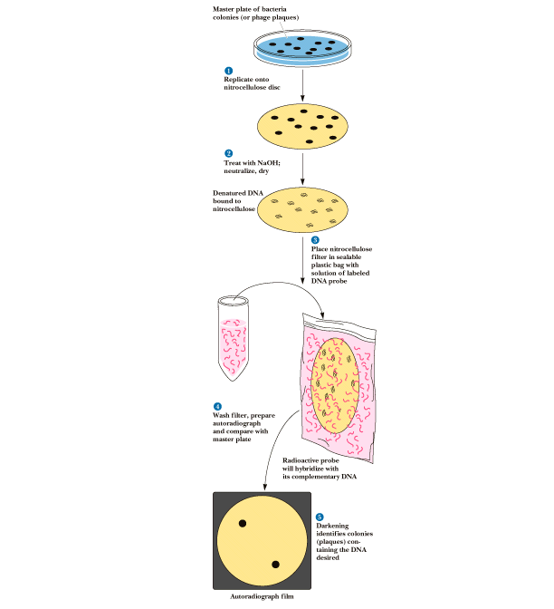
Disk is treated with base or heated to convert dsDNA to ssDNA and incubated with probes
Colonies that bind probe (with P-32) hold the fragment of interest

Slide 39
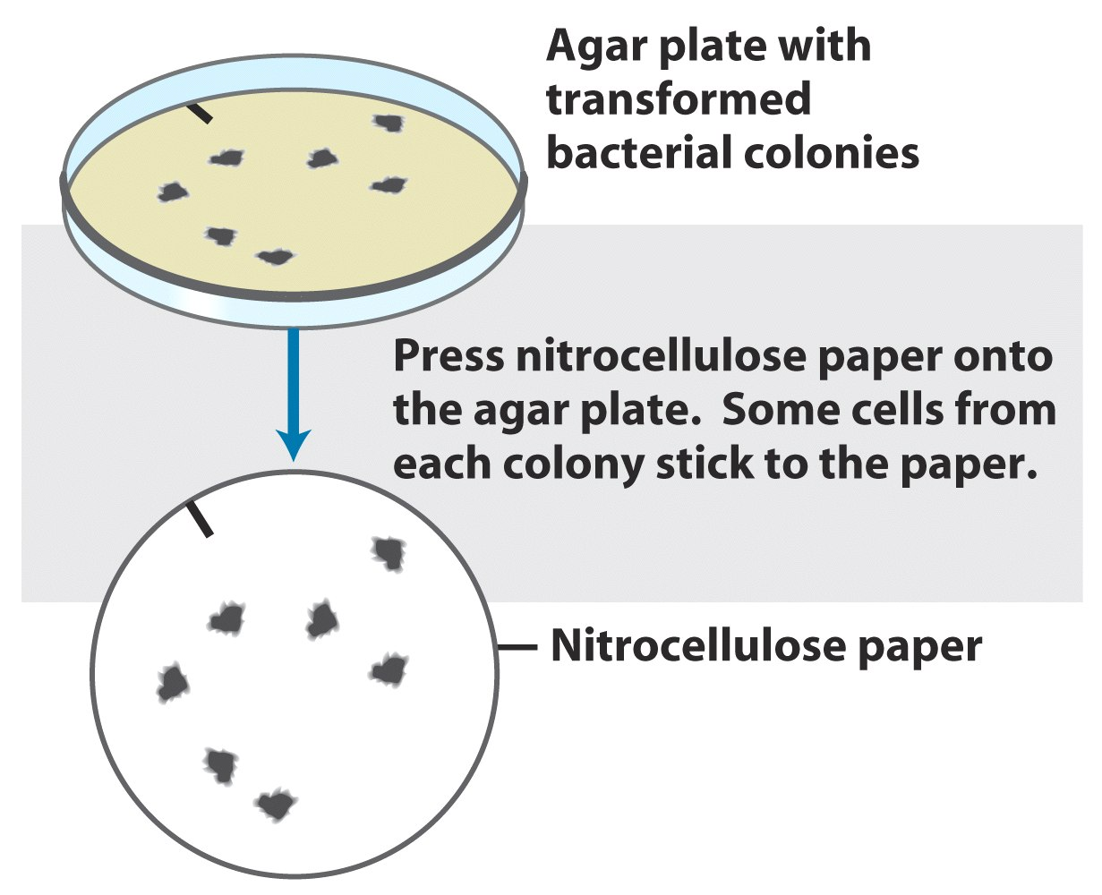
Specific sequences are detectable by hybridization

Slide 40
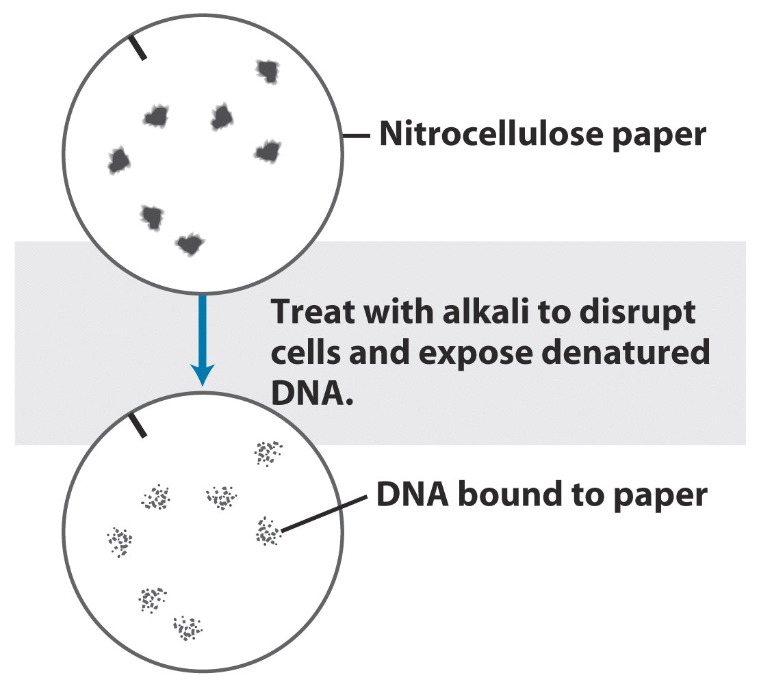

Slide 41
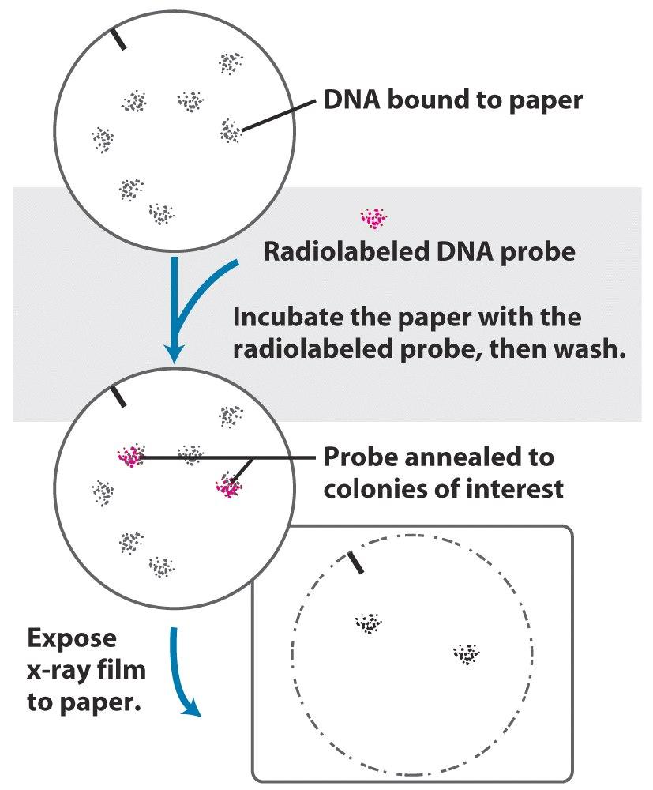

Slide 42
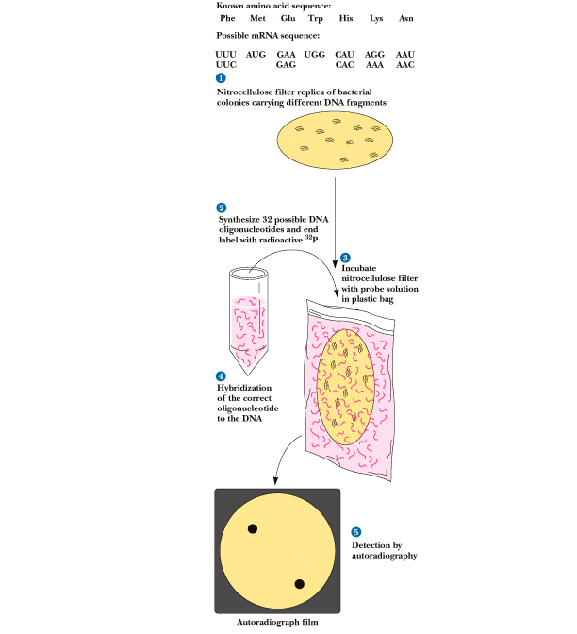

Slide 43
Probe to detect gene for a protein of known amino acid sequence

Slide 44
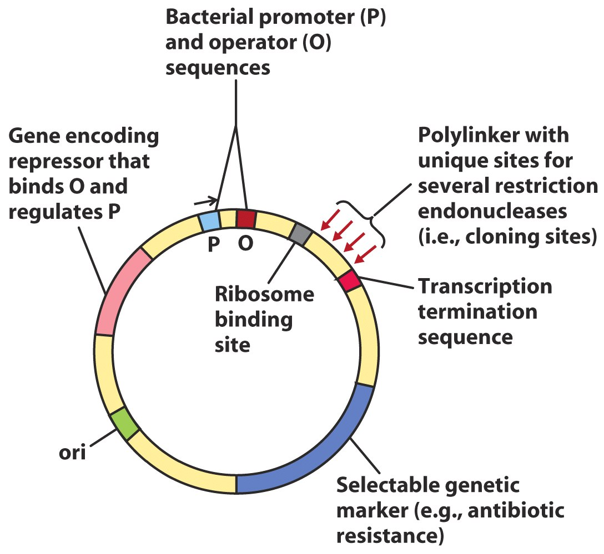
Expression of cloned genes produces large quantities of protein

Slide 45
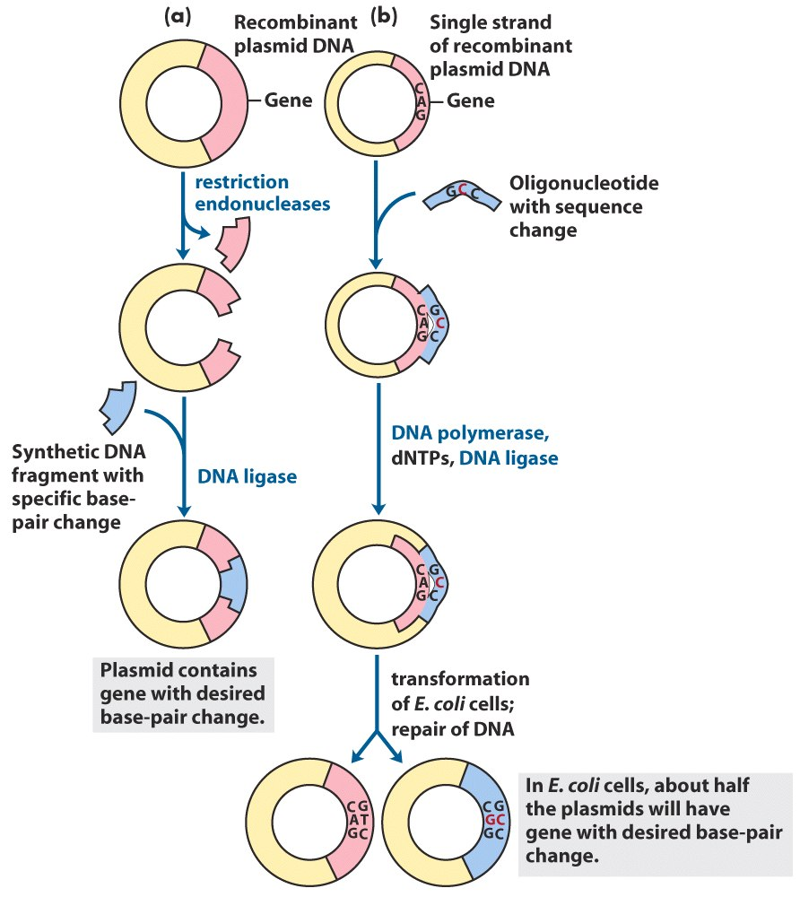
Alterations in cloned genes produce modified proteins
Two approaches to site-directed mutagenesis

Slide 46
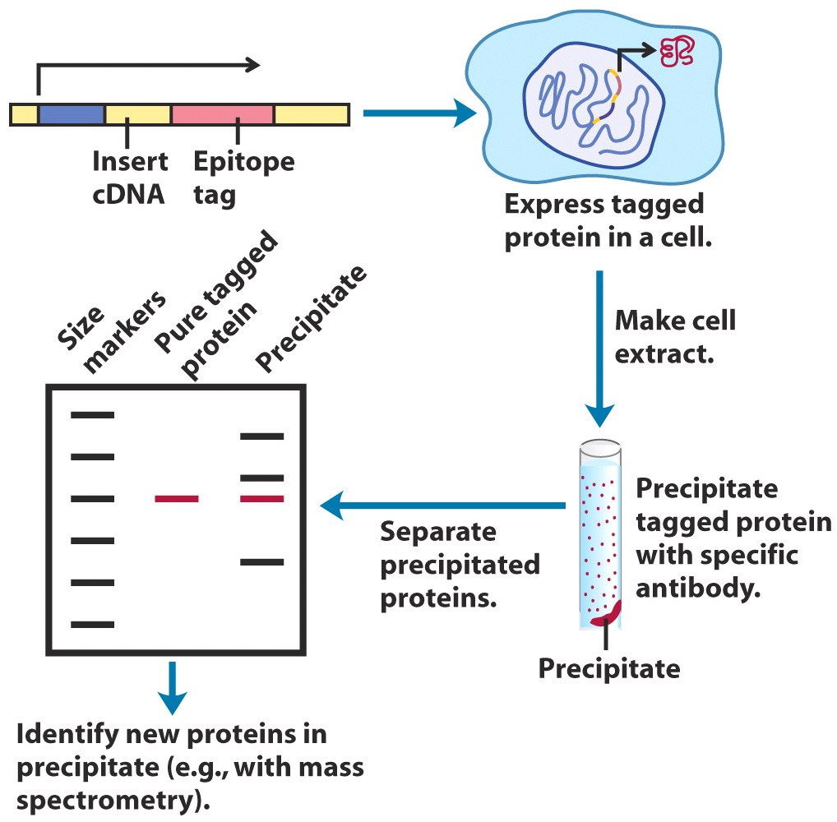
Construction of fusion proteins

Slide 47
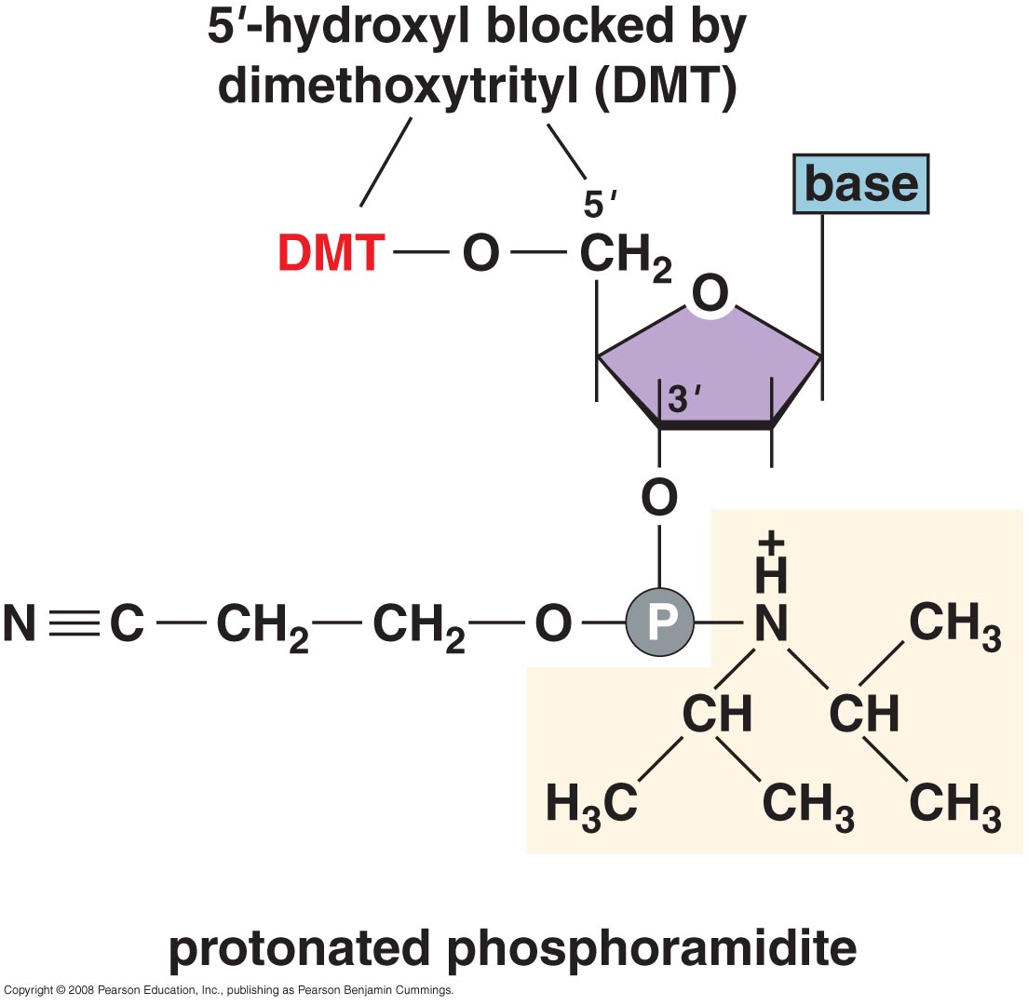
Oligonucleotides can be chemically synthesized

Slide 48
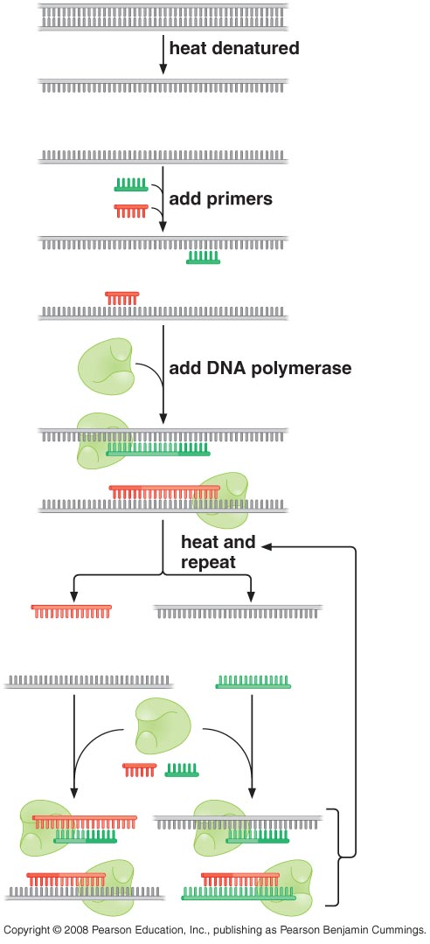
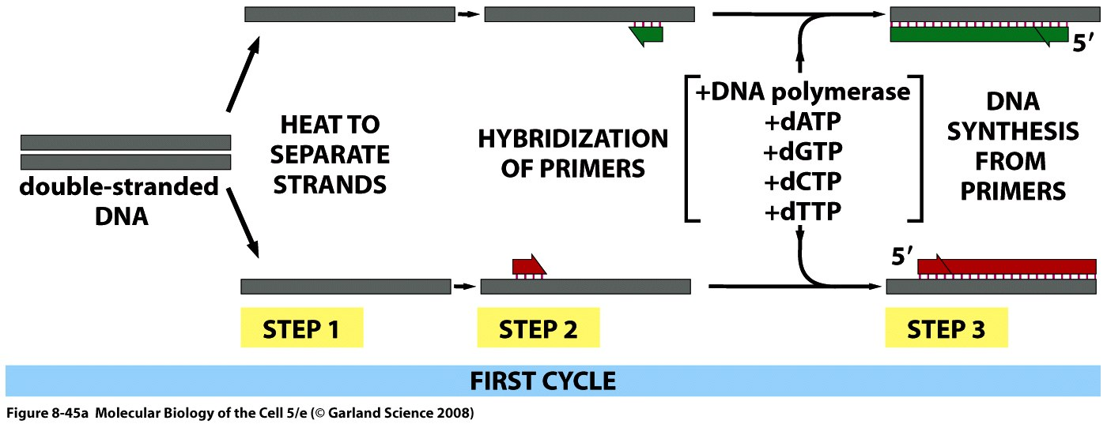
PCR (polymerase chain reaction) amplifies DNAs by repeated rounds of DNA replication in vitro

Slide 49
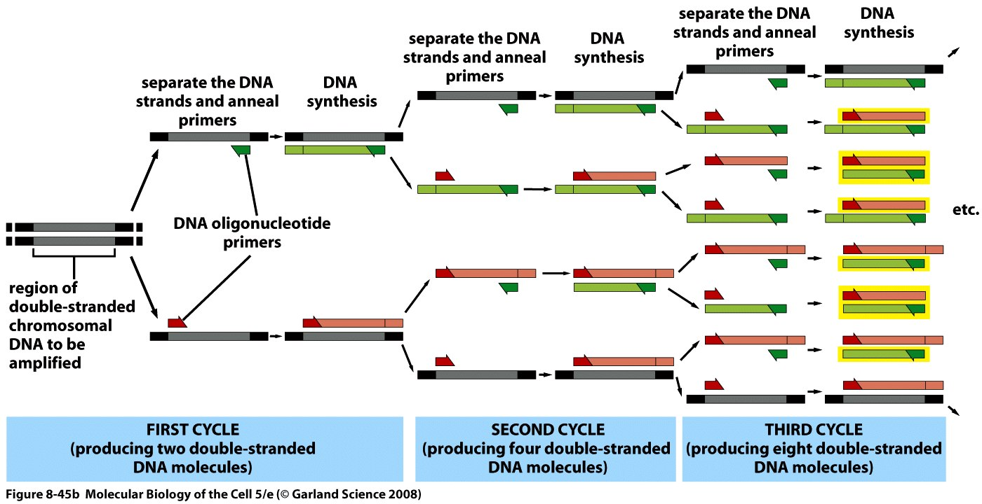

Slide 50
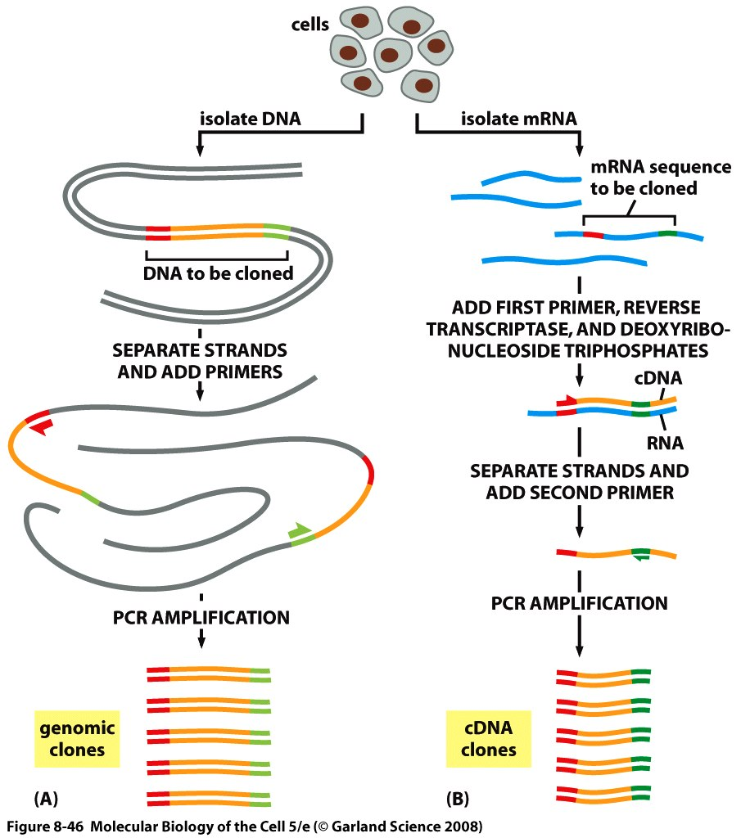
Gene can be selectively amplified by PCR

Slide 51
DNA fingerprinting

Slide 52
The Nobel Prize in Chemistry 1993 was awarded "for contributions to the developments of methods within DNA-based chemistry" jointly with one half to Kary B. Mullis "for his invention of the polymerase chain reaction (PCR) method"and with one half to Michael Smith "for his fundamental contributions to the establishment of oligonucleotide-based, site-directed mutagenesis and its development for protein studies".

Slide 53
How to determine DNA sequences?
ddNTPs used in DNA sequencing

Slide 54
Chain termination in the presence of ddNTPs

Slide 55
DNA sequencing by chain-termination method

Slide 57
DNA sequencing gel

Slide 58
Automated DNA sequencing.
Shown here is a tiny part of the data from an automated DNA-sequencing run as it appears on the computer screen. Each colored peak represents a nucleotide in the DNA sequence—a clear stretch of nucleotide sequence can be read here between positions 173 and 194 from the start of the sequence. This particular example is taken from the international project that determined the complete nucleotide sequence of the genome of the plant Arabidopsis.

Slide 59
The Nobel Prize in Chemistry 1980 was divided, one half awarded to Paul Berg "for his fundamental studies of the biochemistry of nucleic acids, with particular regard to recombinant-DNA",the other half jointly to Walter Gilbert and Frederick Sanger "for their contributions concerning the determination of base sequences in nucleic acids".
Photos: Copyright © The Nobel Foundation

Slide 60
Genomic sequences provide the ultimate genetic libraries
The human genomic project strategy

Slide 61
Shotgun sequencing a bacterial genome then a partial assembly of large genome sequences

Slide 62
Contigs are linked by sequencing the ends of large DNA fragments

Slide 63
The pair-end strategy permits the assembly of large-genome scaffolds

Slide 65
The $500 human genome is within reach

Slide 66
PROTEINS
Specific proteins can be purified from cell extracts
Purification of a protein requires a specific assay for its function

Slide 67
Preparation of cell extracts containing active proteins
Fractionation of cells
The sample is contained in tubes that are inserted into a ring of cylindrical holes in a metal rotor. Rapid rotation of the rotor generates enormous centrifugal forces, which cause particles in the sample to sediment. The vacuum reduces friction, preventing heating of the rotor and allowing the refrigeration system to maintain the sample at 4°C.

Slide 68
Repeated centrifugation at progressively higher speeds will fractionate homogenates of cells into their components. In general, the smaller the subcellular component, the greater is the centrifugal force required to sediment it. Typical values for the various centrifugation steps referred to in the figure are:low speed = 1000 times gravity for 10 minutes; medium speed = 20,000 times gravity for 20 minutes; high speed = 80,000 times gravity for 1 hour; very high speed = 150,000 times gravity for 3 hours.

Slide 69
In velocity sedimentation (A) subcellular components sediment at different speeds according to their size and shape when layered over a dilute solution containing sucrose. To stabilize the sedimenting bands against convective mixing caused by small differences in temperature or solute concentration, the tube contains a continuous shallow gradient of sucrose that increases in concentration toward the bottom of the tube (typically from 5% to 20% sucrose). Following centrifugation, the different components can be collected individually, most simply by puncturing the plastic centrifuge tube and collecting drops from the bottom, as illustrated here. In equilibrium sedimentation (B) subcellular components move up or down when centrifuged in a gradient until they reach a position where their density matches their surroundings. Although a sucrose gradient is shown here, denser gradients, which are especially useful for protein and nucleic acid separation, can be formed from cesium chloride. The final bands, at equilibrium, can be collected as in (A).

Slide 70
Proteins can be separated from one another using column chromatography
The sample, a mixture of different molecules, is applied to the top of a cylindrical glass or plastic column filled with a permeable solid matrix, such as cellulose, immersed in solvent. A large amount of solvent is then pumped slowly through the column and collected in separate tubes as it emerges from the bottom. Because various components of the sample travel at different rates through the column, they are fractionated into different tubes

Slide 71
Ion-exchange

Slide 72
Gel-filtration

Slide 73
Affinity chromatography can facilitate more rapid protein purification
Affinity chromatography (C) uses an insoluble matrix that is covalently linked to a specific ligand, such as an antibody molecule or an enzyme substrate, that will bind a specific protein. Enzyme molecules that bind to immobilized substrates on such columns can be eluted with a concentrated solution of the free form of the substrate molecule, while molecules that bind to immobilized antibodies can be eluted by dissociating the antibody–antigen complex with concentrated salt solutions or solutions of high or low pH. High degrees of purification are often achieved in a single pass through an affinity column.

Slide 74
Genetically-engineered tags provide an easy way to purify proteins

Slide 75
Typical results obtained when three different chromatographic steps are used in succession to purify a protein. In this example a homogenate of cells was first fractionated by allowing it to percolate through an ion-exchange resin packed into a column (A). The column was washed, and the bound proteins were then eluted by passing a solution containing a gradually increasing concentration of salt onto the top of the column. Proteins with the lowest affinity for the ion-exchange resin passed directly through the column and were collected in the earliest fractions eluted from the bottom of the column. The remaining proteins were eluted in sequence according to their affinity for the resin—those proteins binding most tightly to the resin requiring the highest concentration of salt to remove them. The protein of interest was eluted in several fractions and was detected by its enzymatic activity. The fractions with activity were pooled and then applied to a second, gel-filtration column (B). The elution position of the still-impure protein was again determined by its enzymatic activity and the active fractions were pooled and purified to homogeneity on an affinity column (C) that contained an immobilized substrate of the enzyme. (D) Affinity purification of cyclin-binding proteins from S. cerevisiae, as analyzed by SDS polyacrylamide-gel electrophoresis (see Figure 8–14). Lane 1 is a total cell extract; lane 2 shows the proteins eluted from an affinity column containing cyclin B2; lane 3 shows one major protein eluted from a cyclin B3 affinity column. Proteins in lanes 2 and 3 were eluted with salt and the gels was stained with Coomassie blue.

Slide 76
Analyzing proteins
Separation of proteins on polyacryamide gels
The size and subunit composition of a protein can be determined by SDS polyacrylamide gel electrophoresis
These two chemicals are used to solubilize proteins for SDS polyacrylamide- gel electrophoresis. The SDS is shown here in its ionized form.

Slide 78
(A) An electrophoresis apparatus. (B) Individual polypeptide chains form a complex with negatively charged molecules of sodium dodecyl sulfate (SDS) and therefore migrate as a negatively charged SDS-protein complex through a porous gel of polyacrylamide. Because the speed of migration under these conditions is greater the smaller the polypeptide, this technique can be used to determine the approximate molecular weight of a polypeptide chain as well as the subunit composition of a protein. If the protein contains a large amount of carbohydrate, however, it will move anomalously on the gel and its apparent molecular weight estimated by SDS-PAGE will be misleading

Slide 79
The photograph shows a Coomassie-stained gel that has been used to detect the proteins present at successive stages in the purification of an enzyme. The leftmost lane (lane 1) contains the complex mixture of proteins in the starting cell extract, and each succeeding lane analyzes the proteins obtained after a chromatographic fractionation of the protein sample analyzed in the previous lane (see Figure 8–12). The same total amount of protein (10 μg) was loaded onto the gel at the top of each lane. Individual proteins normally appear as sharp, dye-stained bands; a band broadens, however, when it contains too much protein. (From T. Formosa and B.M. Alberts, J. Biol. Chem. 261:6107–6118, 1986.)

Slide 80
Immunoblotting

Slide 81
Protein molecules can be directly sequenced

Slide 82
Use mass spectrometry to identify proteins and to sequence peptides

Slide 85
21_Figure24c.jpg

Slide 86
21_Figure24d.jpg

Slide 87
PROTEOMICS
Combining liquid chromatography with mass spectrometry identifies individual proteins within a complex extract

Slide 88
Proteome comparisons identify important differences between cells
Mass spectrometry can also monitor protein modification states

Slide 89
Protein-protein interactions can yield information about protein function
The physical interaction map of yeast from affinity purification/mass spectrometry

Slide 90
Protein-protein interactions can also be identified by a two-hybrid technique in yeast

Slide 91
Optical methods can monitor protein interactions in real time

Slide 92
Fluorescence resonance energy transfer (FRET)

Slide 93
Protein structure can be determined using X-ray diffraction

Slide 94
Protein structure in solution can be determined using NMR

Slide 95
NUCLEIC ACID-PROTEIN INTERACTIONS
The Gel mobility of DNA is altered by protein binding

Slide 96
Detection of DNA binding proteins
A gel-mobility shift assay.
The principle of the assay is shown schematically in (A). In this example an extract of an antibody-producing cell line is mixed with a radioactive DNA fragment containing about 160 nucleotides of a regulatory DNA sequence from a gene encoding the light chain of the antibody made by the cell line. The effect of the proteins in the extract on the mobility of the DNA fragment is analyzed by polyacrylamide-gel electrophoresis followed by autoradiography. The free DNA fragments migrate rapidly to the bottom of the gel, while those fragments bound to proteins are retarded; the finding of six retarded bands suggests that the extract contains six different sequence-specific DNA-binding proteins (indicated as C1–C6) that bind to this DNA sequence. (For simplicity, any DNA fragments with more than one protein bound have been omitted from the figure.)

Slide 97
DNA-Bound protein protects the DNA from nucleases and chemical modification

Slide 98
DNA footprinting:
RNA pol leaves its footprint on a promoter

Slide 99
Chromatin Immunoprecipitation (ChIP) can detect protein association with DNA in the cell

Slide 100
Chromatin immunoprecipitation.
This methodology allows the identification of the sites in a genome that are occupied in vivo by a gene regulatory protein. The amplification of DNA by the polymerase chain reaction (PCR). The identities of the precipitated, amplified DNA fragments can be determined by hybridizing the mixture of fragments to DNA microarrays.

Slide 101
In vitro selection can be used to identify a protein’s DNA- or RNA-binding site

Slide 102
A method for determining the DNA sequence recognized by a gene regulatory protein.
A purified gene regulatory protein is mixed with millions of different short DNA fragments, each with a different sequence of nucleotides. A collection of such DNA fragments can be produced by programming a DNA synthesizer, a machine that chemically synthesizes DNA of any desired sequence. For example, there are 4¹¹, or approximately 4.2 million possible sequences for a DNA fragment of 11 nucleotides. The double-stranded DNA fragments that bind tightly to the gene regulatory protein are then separated from the DNA fragments that fail to bind. One method for accomplishing this separation is through gel-mobility shifts. After separation of the DNA–protein complexes from the free DNA, the DNA fragments are removed from the protein, and several additional rounds of the same selection process are carried out. The nucleotide sequences of those DNA fragments that remain through multiple rounds of selection can be determined, and a consensus DNA recognition sequence can be generated.

Slide 103
In vitro selection of a synthetic ribozyme.
Beginning with a large pool of nucleic acid molecules synthesized in the laboratory, those rare RNAmolecules that possess a specified catalytic activity can be isolated and studied. Although a specific example (that of an autophosphorylating ribozyme) is shown, variations of this procedure have been used to generate many of the ribozymes. During the autophosphorylation step, the RNA molecules are sufficiently dilute to prevent the “cross”-phosphorylation of additional RNA molecules. In reality, several repetitions of this procedure are necessary to select the very rare RNA molecules with catalytic activity. Thus the material initially eluted from the column is converted back into DNA, amplified many fold (using reverse transcriptase and PCR), transcribed back into RNA, and subjected to repeated rounds of selection.

Slide 105
SELEX sequence logo

